Slide 1
UNIT-III
Fragments

Slide 2
(MR20-1CS0116) Mobile Application Development
UNIT – I Introduction to Android Operating System:
Android OS and Features – Android development framework; Installing and running applications on Android Studio, Creating AVDs, Types of Android application; Creating Activities, Activity Life Cycle, Activity states, monitoring state changes
UNIT – II Android application components :
Android Manifest file, Externalizing recourses like Simple Values, Drawables, Layouts, Menus, etc. Building User Interfaces: Fundamental Android UI design, Layouts – Linear, Relative, Grid and Table Layouts. User Interface (UI) Components
UNIT – III Fragments :
Creating fragments, Lifecycle of fragments, Fragment states, Adding fragments to Activity, adding, removing and replacing fragments with fragment transactions, interfacing between fragments and Activities,
UNIT – IV Intents and Broadcasts:
Using intents to launch Activities, Types of Intents, Passing data to Intents, Getting results from Activities, Broadcast Receivers – Using Intent filters to service implicit Intents, Resolving Intent filters
UNIT – V Database:
Introduction to SQLite database, creating and opening a database, creating tables, inserting retrieving and deleting data;

Slide 3
Syllabus
Creating fragments.
Lifecycle of fragments.
Fragment states.
Adding fragments to Activity.
Adding, removing and replacing fragments with fragment transactions.
Interfacing between fragments and Activities.

Slide 4
Android Fragment is the part of activity, it is also known as sub-activity.
In other words, A Fragment in Android is a component which can be used over an activity to define an independent modular UI component attached to the activity
There can be more than one fragment in an activity.
Fragments represent multiple screen inside one activity.
It functions independently, but as it is linked to the Activity, when an activity is destroyed, the fragment also gets destroyed.
Android fragment lifecycle is affected by activity lifecycle because fragments are included in activity.
Also, a fragment is a re-usable component, hence, a single fragment can be included in multiple activities, if required.
Generally, fragments are used to create multi-pane UI in Android apps.
A Fragment has it's own Layout for the UI (user interface), but we can even define a fragment without any layout, to implement a behaviors which has no user interface, more like a background service.

Slide 5
Main use of Fragments in Android
Following are the 3 main usage of Fragments in Android, for which Fragments were introduced:
Modularity: If a single activity is having too many functional components, its better to divide it into independent fragments, hence making the code more organized and easier to maintain.
Reusability: If we define any particular feature in a fragment, then that feature more or less becomes a reusable component which can be easily integrated into any activity.
Adaptability: If we break UI components of an app screen into fragments, then it becomes easier to change their orientation and placement, based on screen size etc.

Slide 6
Creating Fragments
A fragment represents a modular portion of the user interface within an activity.
A fragment is easier to reuse within activities and layouts. Android devices have a variety of screen sizes and densities.
It simplifies the reuse of components in different layouts and their logic.
We can also use fragments also to support different layouts for landscape and portrait orientation on a smartphone.

Slide 7
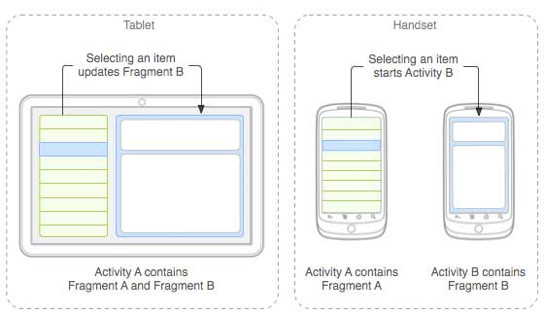
we say a fragment is a kind of sub-activity. It represents a behavior or a portion of user interface in an Activity.
We can combine multiple Fragments in Single Activity to build a multi panel UI and reuse a Fragment in multiple Activities.
Following is a typical example of how two UI modules defined by fragments can be combined into one activity for a tablet design, but separated for a handset design.

Slide 8
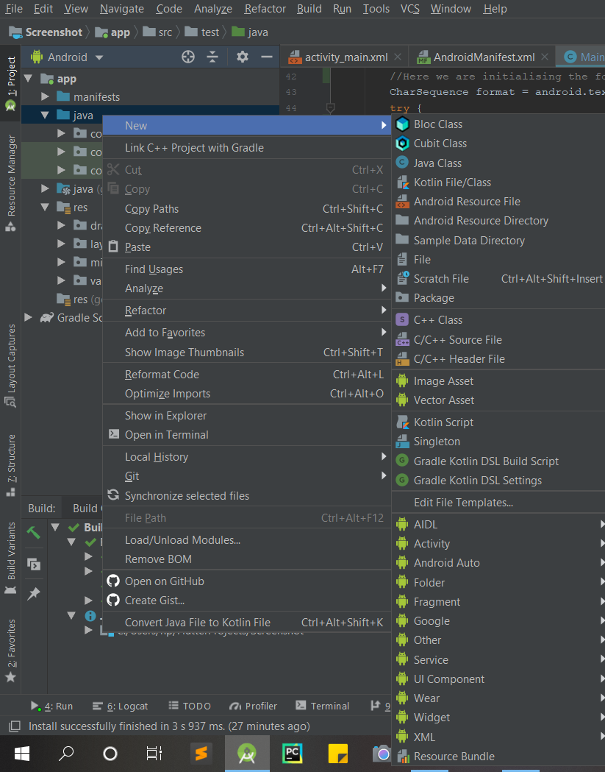
Step by Step Implementation of creating new fragment.
Step 1: Create a New Project in Android Studio
Step 2: Create New Fragment
Right-Click on the First button inside Java, then click on New.

Slide 9
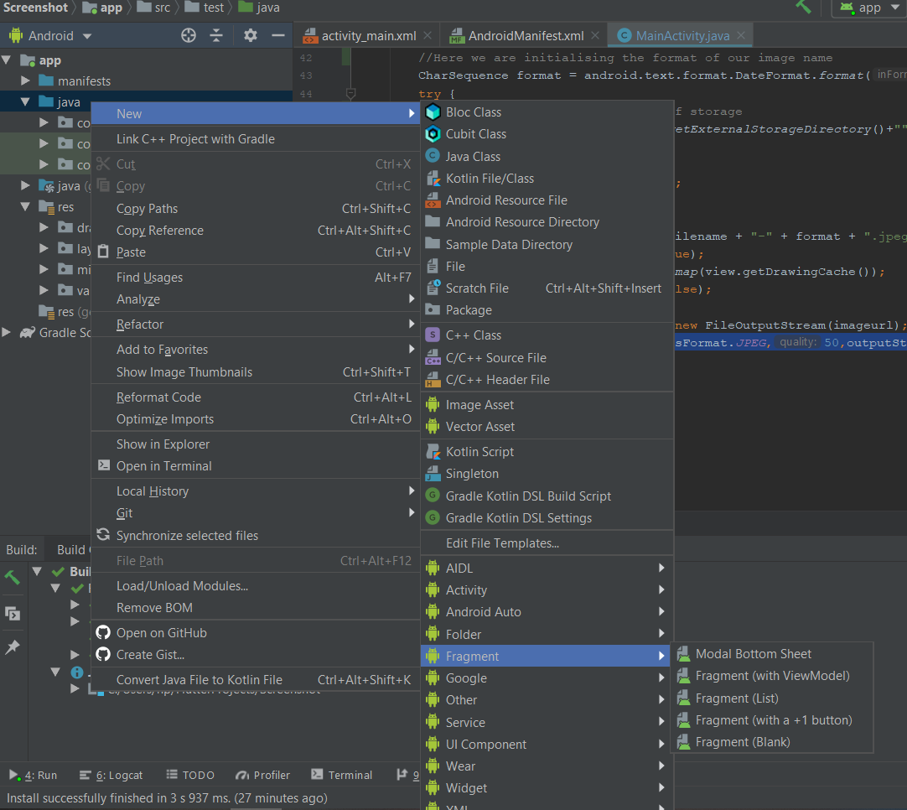
Then Go to Fragment.

Slide 10
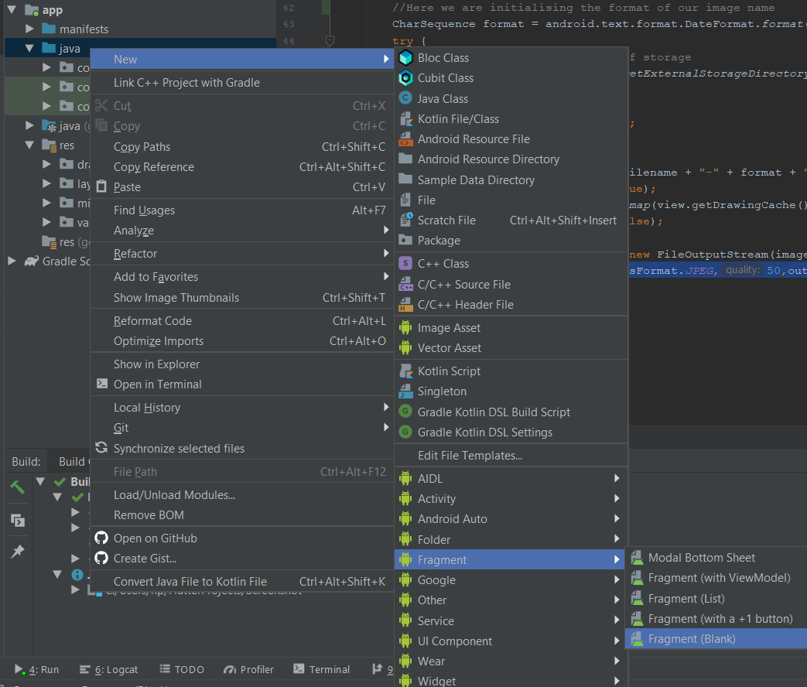
The next step is to choose the Fragment type.
Click on Fragment(Blank).

Slide 11
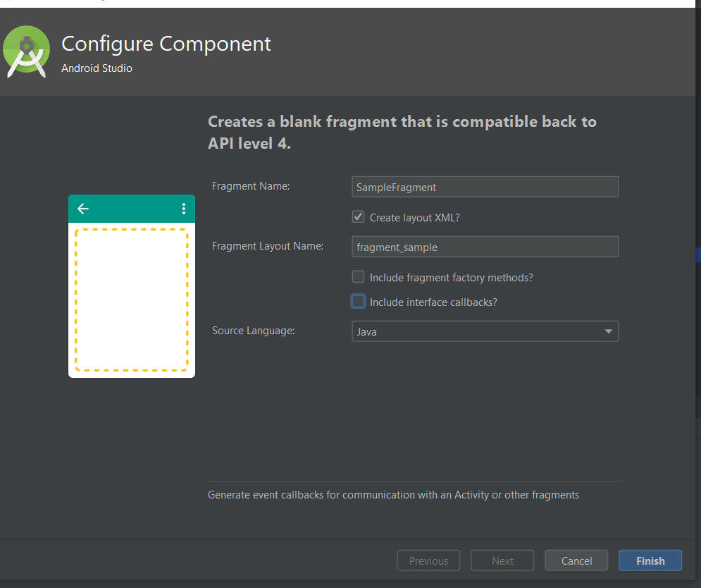
Now, A new Dialog Box will appear.
Then, fill in the Fragment Name text field. An XML file is used to provide functionalities of the user interface for our app. An XML file of the fragment is created using the first word in the fragment name.
Click on Finish. And you have created your Fragment.

Slide 12
Types of Fragments
Basically fragments are divided as three stages as shown below.
Single frame fragments − Single frame fragments are using for hand hold devices like mobiles, here we can show only one fragment as a view.
List fragments − fragments having special list view is called as list fragment
Fragments transaction − Using with fragment transaction. we can move one fragment to another fragment.

Slide 13
Fragment Lifecycle
In Android, Fragment is a part of an activity which enable more modular activity design. Fragment is a kind of sub-activity.
In Android, Fragments have their own life cycle very similar to an Activity but it has extra events that are particular to the Fragment’s view hierarchy, state and attachment to its activity.

Slide 14
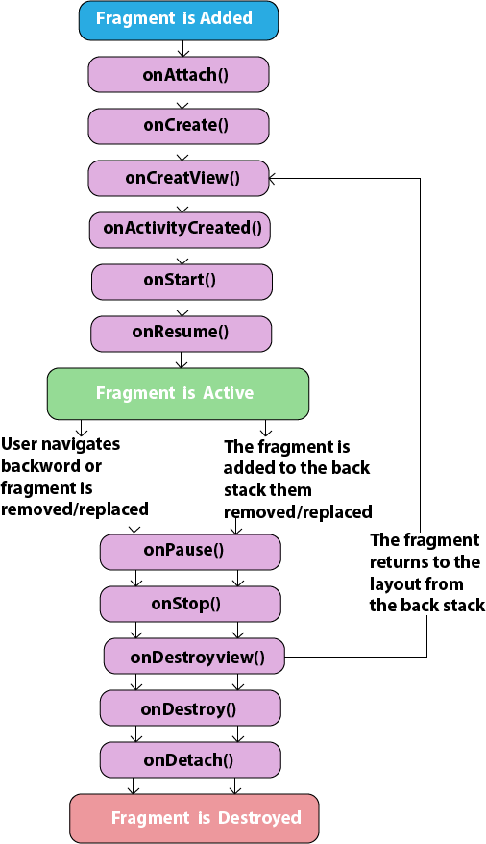

Slide 15
Methods of the Android Fragment:
Methods | Description
onAttach() | The very first method to be called when the fragment has been associated with the activity. This method executes only once during the lifetime of a fragment.
onCreate() | This method initializes the fragment by adding all the required attributes and components.
onCreateView() | System calls this method to create the user interface of the fragment. The root of the fragment’s layout is returned as the View component by this method to draw the UI.
onViewCreated() | It indicates that the activity has been created in which the fragment exists. View hierarchy of the fragment also instantiated before this function call.
onStart() | The system invokes this method to make the fragment visible on the user’s device.
onResume() | This method is called to make the visible fragment interactive.

Slide 16
onPause() | It indicates that the user is leaving the fragment. System call this method to commit the changes made to the fragment.
onStop() | Method to terminate the functioning and visibility of fragment from the user’s screen.
onDestroyView() | System calls this method to clean up all kinds of resources as well as view hierarchy associated with the fragment.
onDestroy() | It is called to perform the final clean up of fragment’s state and its lifecycle.
onDetach() | The system executes this method to disassociate the fragment from its host activity.

Slide 17
Differences between Activity and Fragment
Activity | Fragment
Activity is an application component that gives a user interface where the user can interact. | The fragment is only part of an activity, it basically contributes its UI to that activity.
Activity is not dependent on fragment | Fragment is dependent on activity. It can’t exist independently.
we need to mention all activity it in the manifest.xml file | Fragment is not required to mention in the manifest file
We can’t create multi-screen UI without using fragment in an activity, | After using multiple fragments in a single activity, we can create a multi-screen UI.
Activity can exist without a Fragment | Fragment cannot be used without an Activity.
Creating a project using only Activity then it’s difficult to manage | While Using fragments in the project, the project structure will be good and we can handle it easily.
Lifecycle methods are hosted by OS. The activity has its own life cycle. | Lifecycle methods in fragments are hosted by hosting the activity.
Activity is not lite weight. | The fragment is the lite weight.

Slide 18
Fragment Manager
Each Activity includes a Fragment Manager to manage the Fragments it contains. You can access the Fragment Manager using the getFragmentManager method:
FragmentManager fragmentManager = getFragmentManager();
The Fragment Manager provides the methods used to access the Fragments currently added to the Activity, and to perform Fragment Transaction to add, remove, and replace Fragments.

Slide 19
Fragment Transactions
Fragment Transactions can be used to add, remove, and replace Fragments within an Activity at run time. Using Fragment Transactions, you can make your layouts dynamic — that is, they will adapt and change based on user interactions and application state.
Each Fragment Transaction can include any combination of supported actions, including adding, removing, or replacing Fragments. They also support the specification of the transition animations to display and whether to include the Transaction on the back stack.
A new Fragment Transaction is created using the beginTransaction method from the Activity’s Fragment Manager. Modify the layout using the add, remove, and replace methods, as required, before setting the animations to display, and setting the appropriate back-stack behavior. When you are ready to execute the change, call commit to add the transaction to the UI queue.

Slide 20
FragmentTransaction fragmentTransaction = fragmentManager.beginTransaction();
// Add, remove, and/or replace Fragments.
// Specify animations.
// Add to back stack if required.
fragmentTransaction.commit();

Slide 21
Each of these transaction types and options will be explored in the following sections.
When adding a new UI Fragment, specify the Fragment instance to add, along with the containerView into which the Fragment will be placed. Optionally, you can specify a tag that can later be used to find the Fragment by using the findFragmentByTag method:
FragmentTransaction fragmentTransaction = fragmentManager.beginTransaction(); fragmentTransaction.add(R.id.ui_container, new MyListFragment());
fragmentTransaction.commit();

Slide 22
To remove a Fragment, you first need to find a reference to it, usually using either the Fragment Manager’s findFragmentById or findFragmentByTag methods. Then pass the found Fragment instance as a parameter to the remove method of a Fragment Transaction:
FragmentTransaction fragmentTransaction = fragmentManager.beginTransaction();
Fragment fragment = fragmentManager.findFragmentById(R.id.details_fragment);
fragmentTransaction.remove(fragment);
fragmentTransaction.commit();

Slide 23
You can also replace one Fragment with another. Using the replace method, specify the container ID containing the Fragment to be replaced, the Fragment with which to replace it, and (optionally) a tag to identify the newly inserted Fragment.
FragmentTransaction fragmentTransaction = fragmentManager.beginTransaction();
fragmentTransaction.replace(R.id.details_fragment, new DetailFragment(selected_index)); fragmentTransaction.commit();

Slide 24
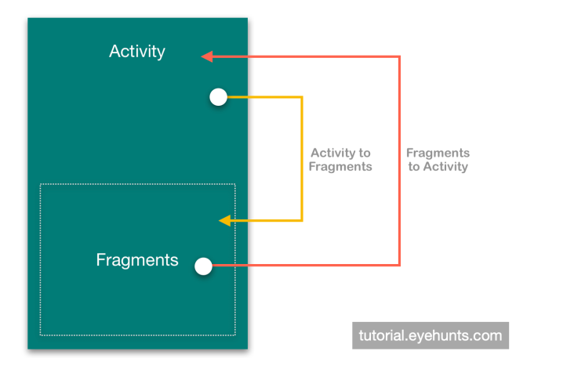
Communication between Activity and Fragment
Activity and fragment communication are important when you want to update data or action.

Slide 25
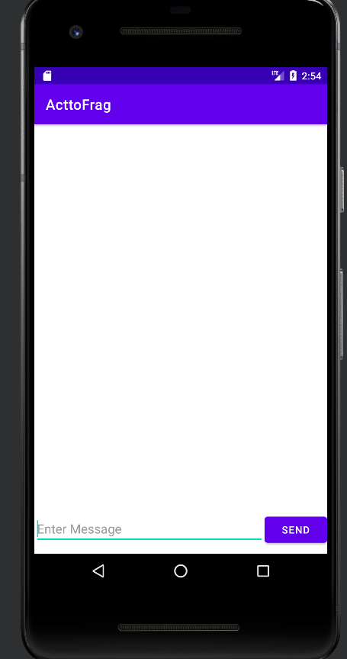
Example that helps you to understand how data can be passed from Activity to Fragment.
Design Screen:

Slide 26
activity_main.xml
<?xml version="1.0" encoding="utf-8"?> <LinearLayout xmlns:android="http://schemas.android.com/apk/res/android" xmlns:tools="http://schemas.android.com/tools" android:layout_width="match_parent" android:layout_height="match_parent" android:orientation="vertical" tools:context=".MainActivity"> <FrameLayout android:layout_weight="1" android:id="@+id/frameLayout" android:layout_width="match_parent" android:layout_height="wrap_content"> </FrameLayout> <LinearLayout android:layout_marginBottom="10dp" android:orientation="horizontal" android:layout_width="match_parent" android:layout_height="wrap_content">

Slide 27
<EditText android:id="@+id/e1" android:layout_weight="1" android:hint="Enter Message" android:layout_width="match_parent" android:layout_height="wrap_content"> </EditText> <Button android:text="Send" android:id="@+id/btn" android:layout_width="wrap_content" android:layout_height="wrap_content"> </Button> </LinearLayout> </LinearLayout>

Slide 28
fragment_first.xml:
<?xml version="1.0" encoding="utf-8"?> <FrameLayout xmlns:android="http://schemas.android.com/apk/res/android" xmlns:tools="http://schemas.android.com/tools" android:layout_width="match_parent" android:layout_height="match_parent" android:background=" #CAF1DE" tools:context=".FirstFragment"> <TextView android:id="@+id/t1" android:textColor="@color/purple_200" android:textStyle="bold" android:textSize="20sp" android:layout_gravity="center" android:gravity="center" android:layout_width="match_parent" android:layout_height="match_parent" /> </FrameLayout>

Slide 29
MainActivity.java
package com.example.acttofrag; import androidx.appcompat.app.AppCompatActivity; import androidx.fragment.app.FragmentManager; import androidx.fragment.app.FragmentTransaction; import android.os.Bundle; import android.view.View; import android.widget.EditText; import android.widget.Button; public class MainActivity extends AppCompatActivity { Button btn; EditText e1; @Override protected void onCreate(Bundle savedInstanceState) { super.onCreate(savedInstanceState); setContentView(R.layout.activity_main); e1=findViewById(R.id.e1); btn=findViewById(R.id.btn);

Slide 30
btn.setOnClickListener(new View.OnClickListener() { @Override public void onClick(View view) { FragmentManager fm=getSupportFragmentManager(); FragmentTransaction ft=fm.beginTransaction(); Bundle bundle=new Bundle(); bundle.putString("message",e1.getText().toString()); FirstFragment f1=new FirstFragment(); f1.setArguments(bundle); ft.replace(R.id.frameLayout,f1).commit(); } }); } }

Slide 31
FirstFragment.java
public View onCreateView(LayoutInflater inflater, ViewGroup container, Bundle savedInstanceState) { // Inflate the layout for this fragment View view= inflater.inflate(R.layout.fragment_first, container, false); TextView t1=view.findViewById(R.id.t1); t1.setText(this.getArguments().getString("message")); return view; }

Slide 32
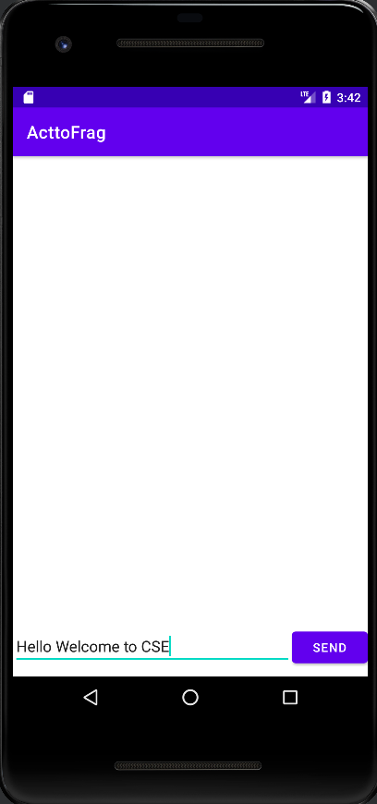
Output Screens:

Slide 33
